Slide 1

CHOOSE THE PATH TO CERTIFICATION: CPRP PREP

Slide 2
Introductions
Who are we
  Dan McLean Professor University of Nevada, Las Vegas
  Dirk Richwine CRPE, Recreation Superintendent Henderson,

Slide 3

Professional Development
Why become involved with State and National Associations
  Networking opportunities/Building connections
  Become part of the movement through advocacy
  Jump start your career
  Volunteer opportunities
  Resource availability
Notes:
Professional development is crucial for accomplishing career goals
Membership within State and National Associations is an easy method for seeking professional growth.
(Talk about slide)
Certification is another method in which professionals can achieve career goals.

Slide 4
PARK AND RECREATION PROFESSIONAL CERTIFICATIONS

Slide 5
Certified Park and Recreation Professional (CPRP)
Certification for individuals in the field of parks and recreation
Certification exam is offered to individuals that meet qualifications.
Certification cycle is 2 years and maintained through achieving 2.0 Continuing Education Units (CEUs).
Notes:
CPRP certification is the national standard for all parks and recreation professionals who want to be at the forefront of their profession.
CPRP Certification is achieved by successfully passing the CPRP Certification Examination.
CPRP Examination can be taken at computer-based testing facilities throughout the US.
CPRP Examination is a 150 question exam – 25 questions are pre-test
CPRP Certification lasts for 2 years
Renewal is achieved by obtaining 2.0 CEUs within the 2 year certification cycle. CEUs must be achieved in topics highlighted by the CPRP core competencies and job tasks (i.e. programming, general administration, and operations management.
Exam fees - $255 NRPA Members/$299 Non-NRPA Members
Study materials include CPRP Study Guide, CPRP Practice Exam
www.nrpa.org/cprp

Slide 6

Certified Park and Recreation Executive (CPRE)
The CPRE establishes a national standard for managerial, administrative and executive parks and recreation professionals.
Qualifications to sit for the CPRP Examination
have a current CPRP Certification and
have a Bachelors degree and 5 years of professional full-time manager experience or
have a Masters degree or higher and 4 years of professional full-time manager experience
Certification was established in 2011. The first CPRE examinations will be administered at the 2011 Congress in Atlanta, GA.
Notes:
CPRE certification places you in the company of an elite group of parks and recreation managers and executives and connects you to the latest trends and information.
Qualifications to sit for the CPRE Examination
have a current CPRP Certification and
have a Bachelors degree and 5 years of professional full-time manager experience or
have a Masters degree or higher and 4 years of professional full-time manager experience
CPRE Certification is achieved by successfully passing the CPRE Certification Examination.
CPRE Examination can be taken at computer-based testing facilities throughout the US, Canada and Dantes sites beginning March 2012.
CPRE Examination is a 150 question exam – 25 questions are pre-test (individuals must score a 97 to pass)
CPRE Certification lasts for 3 years
Renewal is achieved by obtaining 3.0 CEUs within the 3 year certification cycle. CEUs must be achieved in topics highlighted by the CPRE core competencies and job tasks (Communication, Human Resources, Policies, etc.)
Exam fees - $340 NRPA Members/$399 Non-NRPA Members
Reference materials are listed in the CPRE Candidate Handbook to assist with examination preparation.
www.nrpa.org/cpre

Slide 7
History of the CPRP Certification
1950’s - Park and Recreation Professional Registry
1970’s - Certified Leisure Professional (CLP) Certification
1991 - First CLP examination
2000 - Certified Leisure Professional (CLP) transitioned to Certification Park and Recreation Professional (CPRP)
2008 - Certification documents were centralized to NRPA
2011 - CPRP Job Analysis
2011 - CPRE Creation/Implementation

Slide 8
CPRP Eligibility Requirements
Have just received, or are set to receive, a Bachelor’s degree from a program accredited by the Council on Accreditation(Students who have not yet graduated from an COA accredited program with a major in recreation, park resources, and leisure services but are in their final semester on campus may be able to qualify for exam status)
Have a Bachelor’s degree from any institution in recreation, park resources, or leisure services; and also have no less than 1 year of full-time experience in the field
Have a Bachelor’s degree in a major other than recreation, park resources, or leisure services; and also have no less than 3 years of full-time experience in the field
Have a high school degree or equivalent, and have 5 years of full-time experience in the field
**1 year of part-time work experience in the field (20 hours+ per week) = 6 months of full-time work experience in the field

Slide 9
Why CPRP Certification – Professional view
Credibility
Career Advantage
Practical Skills
Community
Global Recognition
Notes:
Global recognition - with more than thirty years of maintaining a rigorous focus on relevant knowledge, the CPRP program is the most widely known and respected credential in the parks and recreation field.
Community - CPRPs stay ahead in their profession by knowing first what’s happening in the field and through networking opportunities.
Practical Skills - The CPRP program focuses on the practical knowledge and current real-world skills necessary in today’s changing parks and recreation field.
Career Advantage - Employers recognize the CPRP as a reliable way to differentiate the most qualified, up-to-date, and determined job applicants, frequently preferring the CPRP as a job requirement.

Slide 10
Why CPRP Certification – Employer view
Credibility
Effective & Efficient Professionals
Competent Professionals + Higher Performance = Budget Efficiency
Highest Service, Education and Professional Excellence
Broad Perspective and Demonstrated Professionalism
Notes:
Now that you have seen why certification is valuable from your professional view lets look at why employers are attracted to CPRP certified professionals from their perspective.

Slide 11
Exam Summary
3 Hour Allotted Time
150 Questions (125 Scored, 25 Pre-test questions)
Computer-based test results are provided directly following examination
The examination content outline (core competencies) will assist you in preparation by providing number of questions

Slide 12
2011/12 Changes
Core Competencies
  Current CBT (General Administration, Programming, and Operations Management)
  CBT beginning March (Finance, Human Resources, Operations, and Programming)
Passing Score
  Current (83 out of 125)
  March (84 out of 125)
Notes:
Quality examination items were kept from past exams however all examination items were reviewed due to changes and to ensure relevancy.
Benefits individuals taking the first examination as you are the initial group to set the bar.

Slide 13
Keep in Mind
Questions are created from Park and Recreation Reference Books
Questions are written from an Educators point of view
Think national not regional
Believe in yourself and your knowledge

Slide 14
PRE-TEST

Slide 15
OPERATIONS

Slide 16

Customer Service
Systematic way of meeting the customer’s needs and responding to complaints and disputes.
Important for an organization internally and externally
You know good customer service when you see it

Slide 17
Steps to Customer Service
Receive without comment
Acknowledge & inform person of the next step
Forward to appropriate person
Handle the complaint
Follow up

Slide 18

Emergency Response
Respond to Emergencies
  First Aid/CPR
  Accident/Incident Reports
  Know emergency action plan
Follow the emergency action plan
  Identify threats
  Create an emergency operations plan
  Develop an evacuation plan
Implement an emergency action plan
  Weather
  Plants and animals
  Societal threats
  Coordinate with local/state/federal officials
Provide input for a general security/safety plan
- Regular safety inspections

Slide 19
Americans with Disabilities Act (ADA)
Americans with Disabilities Act (ADA)
Enacted January 26, 1992
  Requires physical alterations to public accommodations undertaken after 1/26/92 to be readily accessible to & useable by people with disabilities to the maximum extent feasible
  Any facilities built after 1/26/92 must be readily accessible for people with disabilities
  Agencies that own, lease, lease out or operate*MUST* remove barriers

Slide 20
Reasonable Accommodation
Americans with Disabilities Act
Disability – mental or physical impairment limits major life activity
  CANNOT refuse participate because of the disability
  Must make REASONABLE ACCOMMODATION
  NO special charges
  NOT excluded from services due to inaccessible facilities
  Even if separate services operated, right to participate in regular services provided by the agency (inclusion)

Slide 21

Work with Outside Groups
Benefits include efficiency & avoiding duplication of services
Require collaboration & communication
Written agreement that outlines:
  Legal responsibilities/liabilities
  Staff & program supervision details
  Quality control
  Partnership dissolution & review processes

Slide 22

Network with Related Organizations
Other related Organizations
  Districts/Departments
  State Affiliates
  Professional Associations
Professional Networking
  Keep updated with current trends
  Share resources
  Find ways to work cooperatively to enhance services and improve efficiencies

Slide 23
Provide Input for Capital Improvements
Capital Budget: Separate from Operating Budget. Includes planned and proposed expenditures for long-term and substantial projects
Capital Project: Project that is extremely costly. Facility Construction, Large Vehicles, Land Acquisition.
Capital Budget Plans: 5-10 year plans are the norm
Policies: Any purchase/project over $______ is to be considered a capital purchase or project.

Slide 24
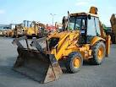
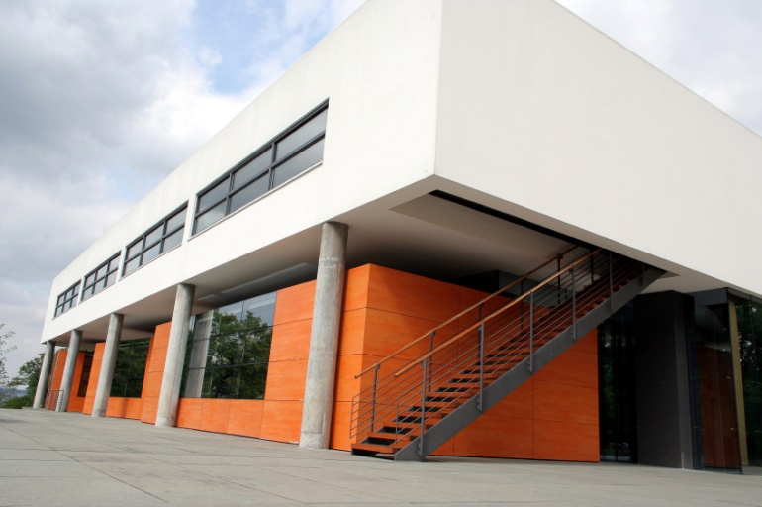
Provide Input for Capital Improvements
Input from all levels of the organization is vital to creating a capital budget.
Examples of Input for Capital Improvements from staff:
Capital acquisitions for programs, facility or agency
Develop areas and facilities
Repair existing areas or facilities
Replace equipment for safety purposes
Enhance/expand recreation opportunities/services
Improve the natural environment
Capital Improvement Proposals should:
Identify the benefits of the capital item
Projected life of the capital item
Possible sources of funding

Slide 25

Maintain Information Systems
Information Technology is: the means by which area personnel perform their information tasks . Org is comprised of many ops and admin functional areas – computers, registration systems, reservations systems………..
  Umbrella term – covers a vast array of computer disciplines allowing orgs to manage their information resources.
  Reshaping Organizations – investment in computing & communications to market, customer service, streamline ops, etc.
  Benefits:
  1. empowers people to do what they want to do.
  2. lets people be creative
  3. lets people be productive.
  3. lets people learn things

Slide 26
Maintain Information Systems
  Basic Functions of Information Systems:
  1. Input- collecting data
  2. Communication – access/movement of data from
  one place to another
  3. Processing – Transferring of data
  4. Storage – keeping data for future use/reference
  5. Retrieval – Recall of data when necessary
  6. Output – transforming data into usable format
1980s – Terminals smaller and on desks.
Electronic Data Entry – Park & Recreation professional
can do own data entry – basic computer skills necessary.

Slide 27



Maintain Information Systems

Slide 28

Maintain Information Systems
1990s – PCs – immediate access to computer functions – Word processing – spreadsheets - email.
Little or no tech classes in R&P degree programs
2000s – Information Systems – one information resource (includes telephone)
Records Management
System is the lifeblood
of an organization.

Slide 29

Maintain Information Systems
THREE MAJOR BIS Classifications for Parks & Recreation
a. TRANSACTIONS SYSTEMS - Activity Registration, Facility Scheduling, Membership Systems
b. WORK MANAGEMENT SYSTEMS – Work Orders, Work Requests, Inventories, Project Management, Maintenance Schedules.
c. CASE MANAGEMENT SYSTEMS – Tracking of a specific participant or event.
Administrative Systems
Email, Financial, Personnel and Program Records, Property Inventories, Legal Documents, Accident Reports

Slide 30





Maintain Information Systems
Registration
  Program Registration locations should be
  physically accessible to all individuals.
  Types of Registration:

Slide 31

Maintain Information Systems
    Registration Forms
    Keep it simple
    Obtain as much information as possible – why?
    Future Marketing
    What FORMS should include:
    Date * Contact Info * Programs Registering For * Program Fees *
    To whom check written* Liability Release * Payment method Info * Instructions where to send registration

Slide 32
Maintain Information Systems
Registration
Process
Data
Entry
Staffing
Registration
Registration
Procedures
Participant
Cash
Handling
Supplies
Notes:
Staffing – 2 or more or cash reg
Cash handling – procedures/policies
Supplies- for registrants
Procedures – for registering…deadlines, classes, what is a family?
Data entry – front and back end - enter information to register, maintain information, enter registrations where? Who? Online? Who checks?

Slide 33


Maintain Information Systems
How else do we Use/Maintain
Information Systems today?
Use permits
Reservations
Tracking Maintenance
Memberships – Fitness – Aquatics
Equipment use records
Others

Slide 34
Conduct Inventories
REAL ESTATE
CAPITAL
ITEMS
COMMODITIES
SPECIAL
ASSETS
Notes:
Fixed assets - assigned an inventory control number, - inventory is conducted annually
Real estate - deeds, legal descriptions of property owned – just be aware of existence
Capital items – all agencies maintain an inventory – usually exceeds a certain amount, $1000 ex. – vehicles, fitness equipment, FF&E, playground equipment, lift for a pool, computers, printers, etc.
Special assets – zoo animals, art galleries, - unique
Commodities – items used every day – maintenance supplies, toilet paper, paper towels, office supplies, program supplies, art supplies, etc.

Slide 35

Monitoring Contractors/Concessionaires
RFP – framework for work/service to be done or provided
WRITTEN POLICY- with parameters of hiring (reasons).
SERVICE - written contractual agreements - defining the service to be provided, the expectations, length of service, financial arrangements, agency oversight and performance standards.
MONITORING
Concessionaires – Contractors – Contract Instructors
Monthly Reporting – Revenue/Expense Reports- Issues-Attendance
Inspections – Announced and Unannounced – Secret Shoppers
Complaints – Review all
End-user Satisfaction - Surveys

Slide 36

SITE PLANS/MAPS
Site Plan - A site plan is a top view, bird’s eye view of a property that is drawn to scale. A site plan can show:
Property lines
Outline of existing and proposed buildings and structures
Distance between buildings
Distance between buildings and property lines (setbacks)
Parking lots, indicating parking spaces
Driveways/trails
Utilities/Easements
Surrounding streets
Landscaped/Natural Areas – existing/proposed
Ground sign location
Ground Elevations

Slide 37

SITE PLANS/MAPS
Reading/Reviewing Site Plans – Maps
Legitimacy – does plan meet all requirements set forth by the agency?
Compliance – is the drawing accurate and consistent with
any local zoning or code requirements?
3. Consistency – is the site plan consistent with the agency’s
master plan?
4. Maps/Map Overlays

Slide 38
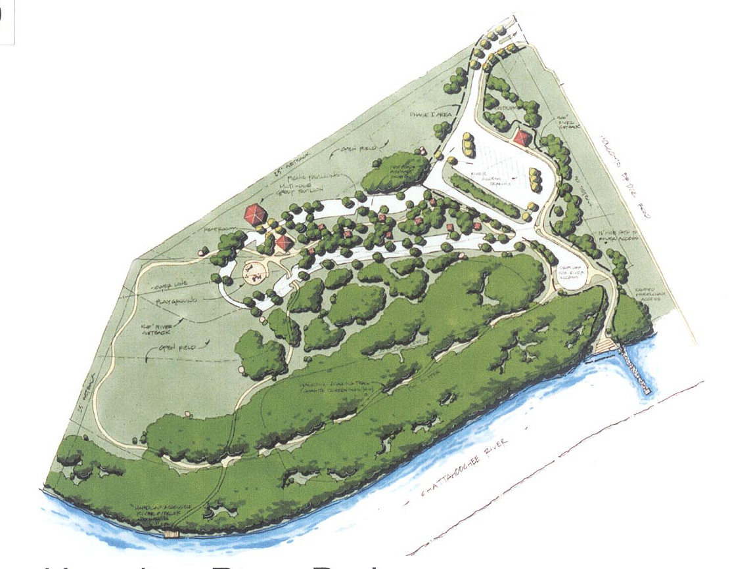
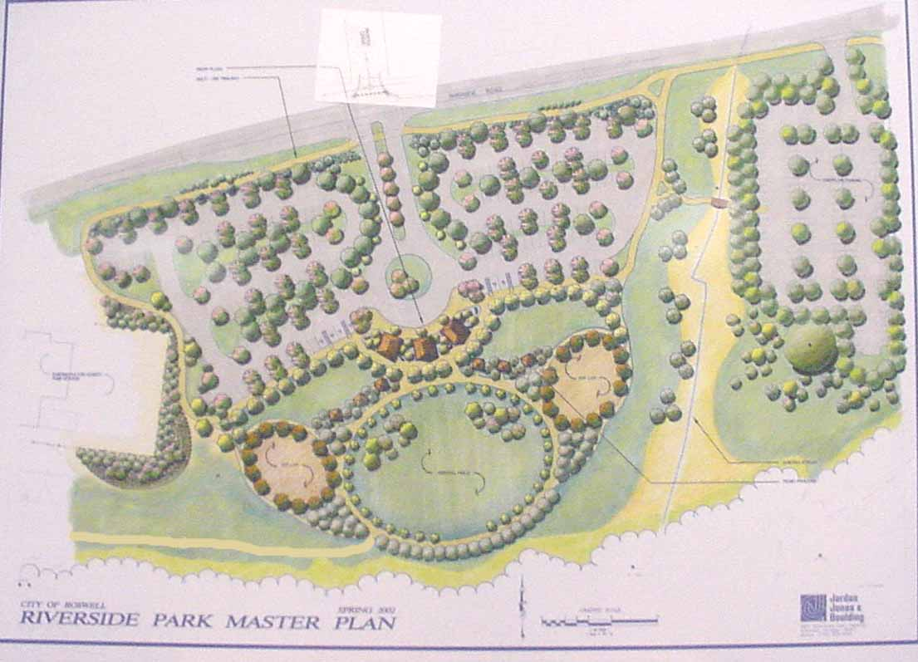

Slide 39
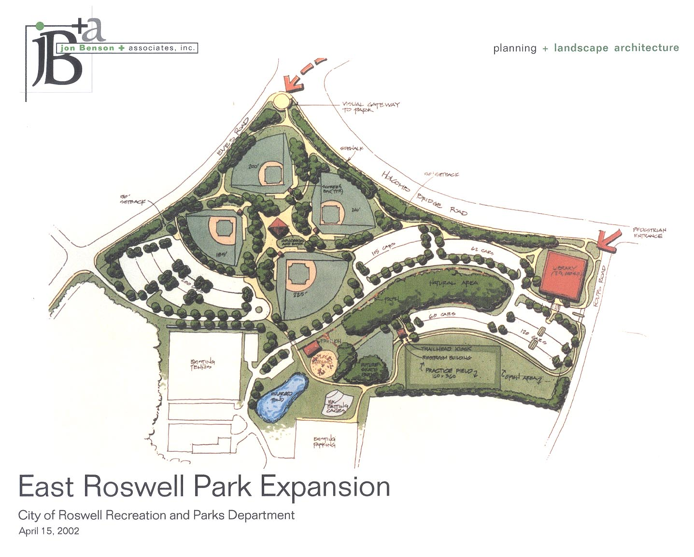

Slide 40

Conduct Needs Assessments
What is a needs assessment?
  Survey: provides accurate feedback on community attitudes, opinions, and perceptions of the park and recreation agency’s resources.
    Programming
    Facilities
    Park Areas
    Products
    Services

Slide 41

Direct Supervision
Supervision of Specific Facilities and Areas
*Know your policies and procedures*
Opening procedures
Routine
Closing Procedures
Inspections
Monitoring of Activities
Staffing

Slide 42
Policies and Procedures - Implementation
Why implement policies and procedures?
Provide fair and consistent treatment
Maintain compliance with County, State and Federal laws or guidelines
Protection of employee, participants and agency
Reduction of confusion

Slide 43
Implementing Policies and Procedures
Daily
  Opening:
    Review of safety of facilities
      Temp, lighting, etc…
      Note irregularities (broken items, vandalism, a theft etc..)
    Facility Room prep for daily events
      Karate vs. Senior Fitness

Slide 44
Implementing Policies and Procedures
Opening Checklist (Example)
  Examine each are for evidence of break ins or unauthorized entry and respond accordingly.
  Unlock areas needed for operations
  Inspect for obvious general hazards (If found correct and repair)
  Inspect rooms for cleanliness

Slide 45
Implementing Policies and Procedures
Closing Checklist (Example)
  Systematically inspect and close down and secure premises.
    Begin with interior rooms
    Ensure all participants have left the facility
  Turn off unnecessary light
  Flush all toilets that are soiled
  Complete work orders for maintenance of items broken during the day
  Set Alarms

Slide 46
Implementing Policies and Procedures
Seasonal
  Opening of Pools
    loading of materials
    repairs from winter damage
  Closing of Pools
    security of supplies, what is kept on site what is stored.
    Locking up facilities for a season

Slide 47
Provide Input for Standard Operating Procedures
Each facility should have a basic checklist of standard procedures
Checking facility washrooms, and activity rooms and high use areas for cleanliness.
Visual Inspections for:
  Proper use of equipment and supplies
  Patron behavior and supervision
  Look for any hazards

Slide 48
Implementing Risk Management
  Security Procedures
  Ensuring Proper Lighting
    Deterrent to theft and vandalism
    Sense of security
  Securing Entrances
  Having people on duty and around to address concerns
    A patrol around a park
    A front desk attendant

Slide 49
Implementing Security/Safety Plan
  ROUTINE INSPECTIONS ARE KEY!!!!
  (when, where, why and how often)
  Know what is to inspected and how often.
  Be consistent, do it on time (when required)
  Go by the checklists that are in the plan for the inspection
  Report maintenance problems and follow up.

Slide 50

Energy Efficient Procedures
US Department of Energy best practices:
  Incorporate goals into strategic plan
  Develop management plan & accounting system
  Ensure quality & quantity of staff, including training & outsourcing
  Document use, problems & maintenance
  Conduct regular assessments & implement changes
  Utilize technology – auto control features
  Use equipment only when needed
  Track actual vs. expected performance

Slide 51
Implementing Maintenance Standards
    Preventative Maintenance
    To improve organizational; efficiency (avoiding “downtime” of an inoperable machine
    Planned
    Frequency
      The nature of the mechanics (how often does it break? How often is it in use?)
      Cost (mower vs. scissors)
      How important is it to service delivery?
      Seasonal (approaching seasons)
        Example: SNOW on October 29th.

Slide 52
Maintenance Standards
Specific
Clearly defined performance levels
Standard: Tile floors wet mopped 1x per day
Productivity Standard: using a 21-inch rotary mower, employee will mow 4,800 sf in 1 hour

Slide 53
Implementing Maintenance Standards
  Routine Maintenance:
  Waxing floors, painting walls, changing filter, adjusting doors, changing light bulbs, cleaning lighting fixtures
  Typically done through a work order
    Can be contracted out
  Staff need to recognize conditions to initiate a work order, and understand the quality level of maintenance desired by the agency

Slide 54
Implementing Maintenance Standards
  Landscape Maintenance:
    Goals and Objectives of the Plan
    A detailed inventory of the site:
      Fauna, facilities, topography, soils, utility and communication lines.
    Listing of Maintenance tasks with standards
      (how you know the task was completed to desired results)
    A format for scheduling round and infrequent maintenance work
      Know what supplies are needed for each type of job, materials and supplies.

Slide 55

Benefits of Certification

Slide 56
PROGRAMMING

Slide 57
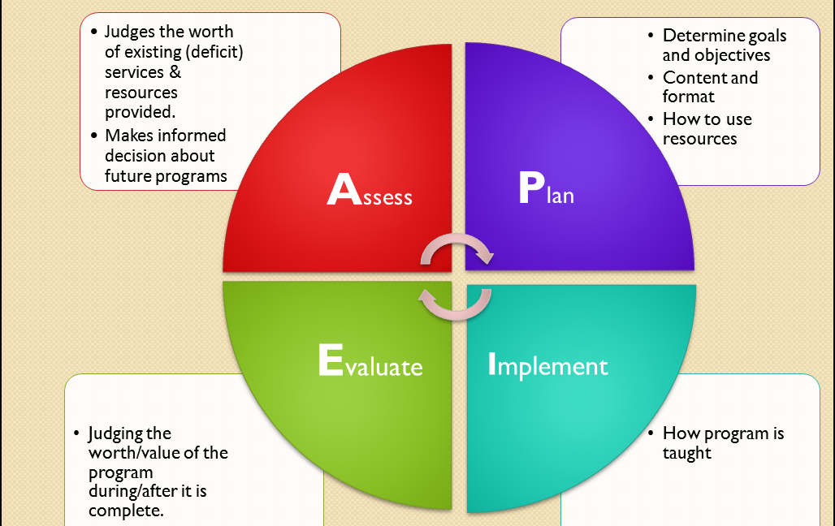

Recreation Planning Process
A-PIE
Assess
Plan
Implement
Evaluate

Slide 58

Assessment: Identify Resources for Programming
AGENCY’S RESOURCES NEED TO BE EXAMINED BEFORE COMMITTING TO A PROGRAM/SERVICE
Fiscal
Physical
  Area
  Equipment
  Supplies
Staff

Slide 59




Assessment – Activity Analysis
Assess each program by conducting an activity analysis
breaking down into each domain area:
Cognitive, social, physical & affective/emotional

Slide 60
Assessment – Identify Target Population
Group of individuals with common interests, demographics, etc.
Used to identify participant needs
Must be:
  measureable
  Accessible
  large enough
Measurable
Accessible
Large enough

Slide 61
Program Planning – Creation and Design
Animate a program: design its flow
Flow: beginning, middle, peak, end
  The concept of a program suggests that a programmer will preconceive and vicariously experience the program intended for the participant and then select the activities (content) and place them in the appropriate order (animate) to orchestrate the occurrence (flow) of the program to achieve the goals and objectives specified.
Beginning
End
Climax
Middle

Slide 62
Program Planning - Development
Program Purpose, Goals & Objectives
Set goals/objectives, content/format, and attract/utilize resources
  Write purpose/goal statements, including:
    Rationale for why connects mission/values
    Behavioral outcomes that will result
Develop participant objectives
    Outcome oriented & measurable
    Elements: conditions, behavior, criteria (accuracy, time & quantity)
    Benefits-based programming
    TR – individualized per participant

Slide 63
Planning - Programs & Special Events
Make arrangements & negotiate prices
Develop a plan to include individuals with disabilities
    Promotion
      nondiscriminatory/welcoming
    Registration & Assessment
      Location & Accommodation/Needs Required?
    Accommodations/Support
      Equipment, adaptations, or staffing
    Staff Training
      Disability awareness/information

Slide 64
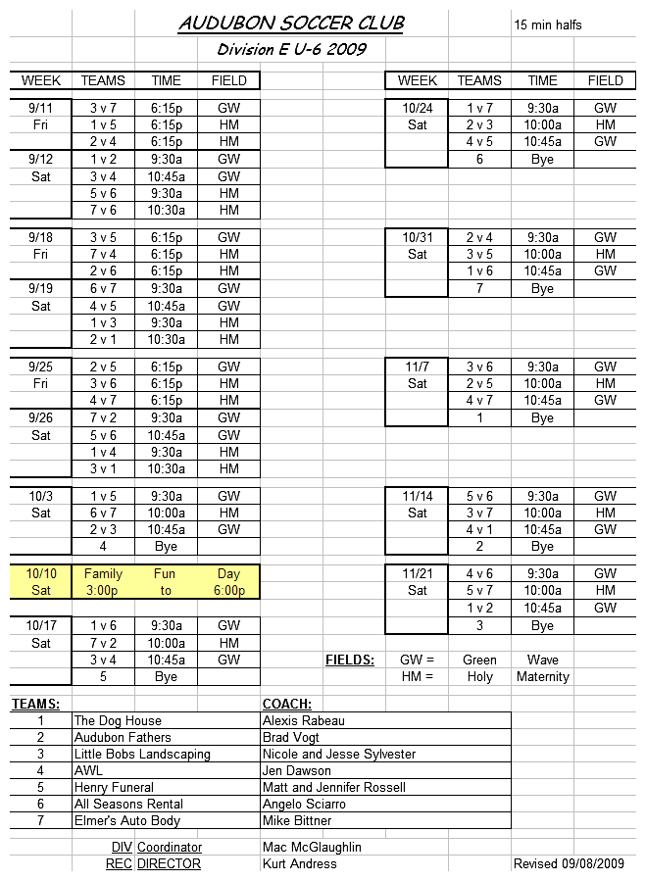
Planning – Scheduling
Develop Schedules – Leagues, Programs, Facilities
Must meet community needs
Variety of different program formats
Must be consistent with facility policies & procedures

Slide 65
Planning Programs & Special Events
Integrate – coordinate with others
    Select format –instructional, league...
    Comprehensive & continuum is optimal
Develop Activities Schedule
Develop Management Plan
  Program Title
  Programming Philosophy
  Goals/Objectives/Benefits
  Promotion Plan
  Financial Plan
  Facility Plan
  Supplies
  Safety/Risk Management
  Staffing Plan
  Management Plan
  Policies
  Operation Plan
  Cancellation Plan
  Program Evaluation Plan

Slide 66
Planning - Specialized Participant Plans
Develop Individualized Participant Plans
Goal-oriented treatment philosophy
Used to develop customized programming based on skill level
Individuals with Disabilities
    Identify problems and needs
    Strengths and abilities
    Client expectations
Varies by agency but typically
includes:
Assessment
Goal
Objectives
Intervention
Outcome/Evaluation
Inclusion Plan

Slide 67
Implement - Supervision of Rec Programs
Supervise Programs & Special Events
  Specific & general
Complete program follow-up
  Inspections, letters, clean up, evaluations
  Individual transition planning (TR)
Promote self-directed activities
Facilitate participation
  Use of facilities, equipment, services, supplies
Assure compliance – standards/regulations

Slide 68
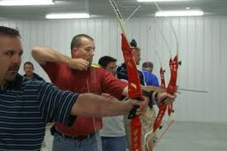
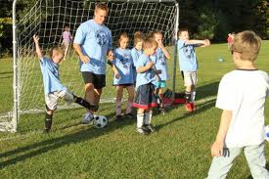


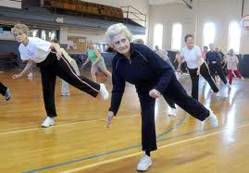

Implement: Work with Variety of Age Groups
Provide balance of programs to meet needs of infants, children, teens, adults and seniors
Maintain positive relationships with clients

Slide 69

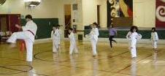
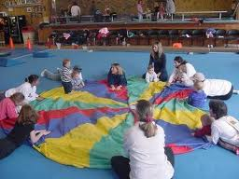
Implement - Facilitate/Lead Programs
Conduct program orientation
  Safety rules, hazards & policies
  Anticipated outcomes
Adapt activities to individual
  Change rules or layout according to needs
  Modifications may be needed:
    Leadership technique
    Programming format
    Physical environment
    Materials/equipment used

Slide 70

Implement - Facilitate/Lead Programs -
Documentation
Program/Participant records/forms
      Program proposal: type of program, market, location, etc.
      Supply requisition: list of supplies
      Reservation form: room reservation
      Maintenance work orders: delivery/set-up
      Contractual services: outside vendors/partners
      Accident & Incident Reports
      Evaluation (after-action): post program
Participant Registration/Reservations
  Variety of methods & forms
  Customer service is key

Slide 71

Evaluation
Formative (during); Summative (Conclusion)
Why evaluate?
  To determine impact
  Cost-benefit analysis
  Satisfaction
  Marketing mix
  Effectiveness of the program
  Value!

Slide 72
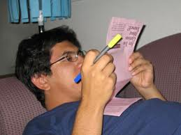
Evaluation – Satisfaction & Outcomes
  Collect Data
    Types – Quantitative & Qualitative
  Sampling
    Random: Everyone has an equal chance of being selected. All names are put into a hat & names are pulled at random
    Systematic: Every “nth” person (i.e., every 5th person who walks in the door)
    Purposive: Represents a select group (i.e., day camp participants)
    Convenience: Easy for the researcher to poll (i.e., available staff or a questionnaire left on the front desk).

Slide 73
Evaluation – Reporting (Statistics)
Comprehensive Program Report
Title
Administrative Location
Purpose, Goals and Objectives
Design/Implementation
Financial data
Staffing plan
Evaluation data
Recommendations for future operations

Slide 74
Evaluation – Stats Help Market Programs
Marketing: creates a positive public perception
Four P’s of Marketing Mix
    Product
    Price
    Place
    Promotion
Product Positioning
Recruit/Retain Clients
Product
Price
Promotion
Place

Slide 75
FINANCES

Slide 76

FINANCES
BUDGET
A prepared plan that anticipates revenues/expected expenses

Slide 77



FINANCES
REVENUES
Money coming into an organization
  Compulsory – Taxes
    Real Estate property (Assessed Evaluation -EAV)
    Personal property, Sales, Excise (Sin), Income
  Gratuitous – Grants, Bequests, Sponsorships, Donations
      State & federal government or private foundations (501(c)3)
  Earned Income – Fees & Charges
  Investment Income
  Contractual Receipts
Notes:
Personal Property – cars, furniture, stocks, bonds
Sales – tangible goods
excise duties are taxes on gasoline and other fuels, and taxes on tobacco and alcohol (sometimes referred to as sin tax).
Fees and Charges – program fees, rentals, etc.
Investment Income – interest gained from unneeded agency funds in money markets, stocks, mutual funds. AAA Bond Rating
Contractual Receipts – Outside contractors- concessions, boat rentals, instructional services
RESEARCH, PROVIDE INPUT PREPARE REQUESTS FOR ALTERNATIVE SUPPORT – IN-KIND SERVICES, MATCHING FUNDS ON TOP OF OTHERS ABOVE.

Slide 78

FINANCES
EXPENSES
A disbursement, expense, or cost related to doing business
  OPERATING EXPENDITURES
    Salaries and Wages
    Supplies
    Utilities
    Maintenance
    Insurance
    Contractual Services
  CAPITAL DISBURSEMENTS
    Purchase of Fixed Assets
    New Construction
    Equipment

Slide 79
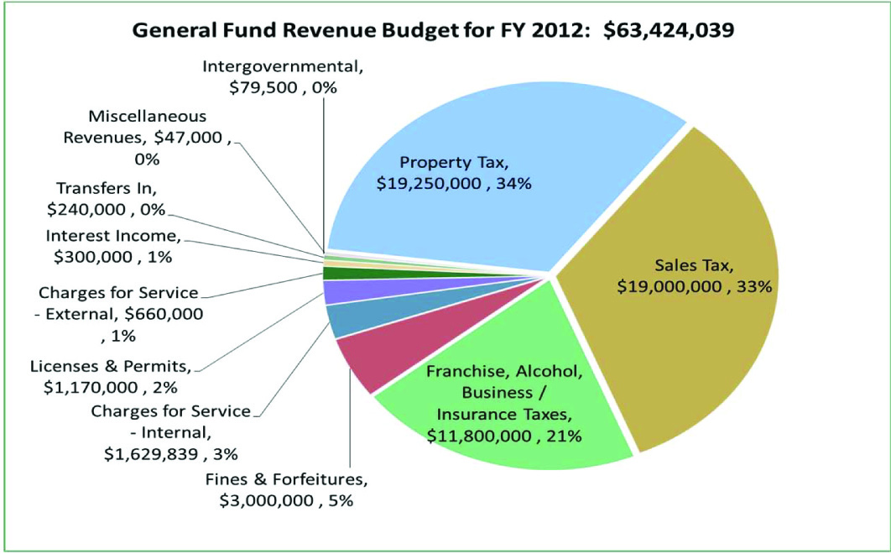
FINANCES
Notes:
Operate within an existing budget

Slide 80
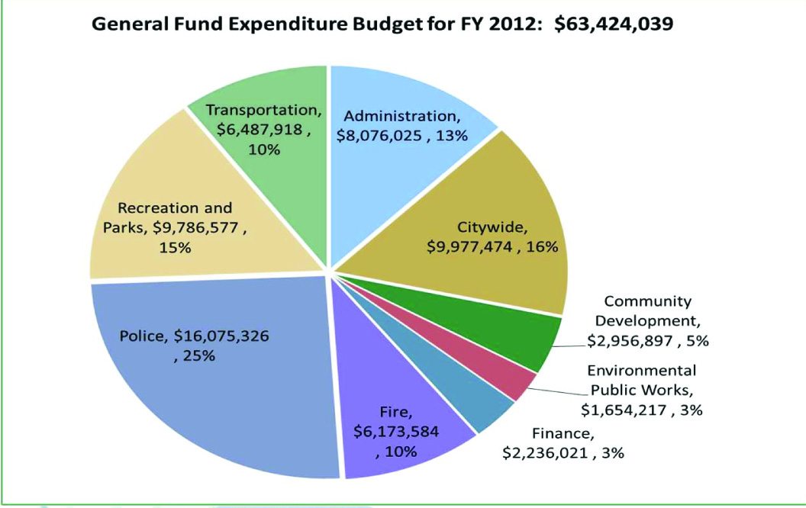
Notes:
Operate within an existing budget

Slide 81

FINANCES
Expense by Line Item…
100 ‐ General Fund $9,786,577 87.0
230 ‐ Impact Fee Fund $225,000
235 ‐ Cemetery Fund $23,500
275 ‐ Hotel/Motel Fund $377,000
290 ‐ Leita Thompson Rental Fund $63,192
310 ‐ 1995 Bond $0
311 ‐ 2000 Bond Fund $0
350 ‐ Capital Projects Fund $872,000
555 ‐ Recreation Participation Fund $4,624,468
Recreation and Parks Total $15,971,737

Slide 82
General Fund Breakdown of Expense
Regular Employees $4,075,700
511105 Part Time Employees $411,870
511300 Overtime $131,021
512200 Social Security (FICA) Contributions $286,850
512300 Medicare $67,010
512400 Retirement Contributions $542,170
512401 Deferred Compensation $23,300
Salaries and Benefits Total $5,537,921
521201 Professional Services $29,473
521300 Technical Services $200
521400 Contract Services $121,391
522110 Disposal $11,000
522130 Custodial $12,200
522140 Repairs And Maintenance ‐ Grounds $69,000
522205 Repairs And Maintenance $331,534
522210 Vehicle Repair $61,299
522320 Rental Of Equipment And Vehicles $12,940
523210 Communication Services $22,000
523220 Postage $4,210
523300 Advertising $28,375
523400 Printing And Binding $14,650
523500 Travel $3,280
523600 Dues And Fees $2,675
523700 Education And Training $1,439
523853 Contracted Interns $1,000
523902 Sanitation Services $54,000
531105 Supplies $302,976
531115 Recreation Supplies $290,500
531120 Vehicle Parts And Supplies $101,500
531210 Water / Sewerage $199,397
531220 Natural Gas $65,000
531230 Electricity $560,081
531240 Bottled Gas $700
531250 Oil $4,500
531270 Gasoline/ Diesel $128,000
531400 Books And Periodicals $300
531605 Machinery And Equipment‐Operating $5,000
531610 Furniture/Fixtures‐Operating $2,575
531615 Computer Equipment‐Operating $5,850
531710 Vietnam Memorial Bricks $400
531720 Uniforms $47,160
Operating Total $2,494,605
552400 Risk/Liability Contribution $210,910
553100 Group Insurance Contribution $848,250
554100 Workers Comp Contribution $36,446
611355 Operating Transfer Out $658,445
Transfers, Capital, Other Total $1,754,051
Recreation and Parks Total $9,786,577

Slide 83
FINANCES
Recreation Participation Fund Revenue by Line Item…
341905 OTHER/MISC. FEES $0
347202 OTHER RENTAL FEES $110,000
347501 GENERAL PROGRAMS $620,000
347502 SPECIAL EVENTS $20,000
347503 ATHLETICS $950,000
347504 TENNIS $100,000
347505 SWIMMING $150,000
347506 GYM & PHYSICAL FITNESS $875,000
347507 DANCE, DRAMA, & MUSIC $300,000
347508 ARTS & CRAFTS $225,000
347509 GENERAL INSTRCTION PROGS $390,000
347510 REC & PARKS CONTRIBUTIONS $46,700
347512 REC & PARKS MISCELLANEOUS $20,000
347513 SENIOR ADULT CENTER $160,000
Charges for Service $3,966,700
361000 INTEREST REVENUES $0
361010 UNREALIZED INVEST GAINS $0
Interest Income Total $0
392200 GAIN/LOSS ON PROPERTY SALE $0
Miscellaneous Revenues Total $0
391201 OPERATING TRANSFER IN $658,445
Transfers In Total $658,445
Recreation Participation Fund Total $4,625,145
Rev $4,625,145
General Fund $9,786,577
Other Revenues $1,560,015
Total Revs. $15,971,737

Slide 84

Prepare Program/Event Budget
FEES AND CHARGES
Programs must: Break Even, Make Money (Surplus) or be Subsidized
Forecasting is essential in price setting – Educated guess
TYPES OF COSTS
    Fixed Costs: Do not change with the number of participants
      Direct Fixed Costs: Cost of program occurring (i.e., renting a room for an activity)
    Indirect/Overhead Costs: Shared fees among programs. (i.e., administrative expenses, utilities, maintenance)
    Variable Costs: Costs for operating the program & based on the number of participants (i.e., t-shirts, supplies, etc.)
Notes:
Fixed Costs: Rental fee remains the same for the room regardless of number of participants
Indirect: These expenses are split out by square footage, divided by number of programs held throughout year, etc.
Variable Costs- Supplies and T-shirts dependent on number of participants enrolled.

Slide 85
Prepare Program/Event Budget
Program Cost = (F+V)N
Fixed Costs + Variable Costs
X
Number of Participants
=
Program Cost

Slide 86

Prepare Program/Event Budget
SPOOKY CRAFTS
Expenses
18 Necklaces x $_____________ = ____________
18 Tootsie Pops x $___________ = ___________
Napkins (1) x $____________ = ______________
Ribbon (1) x $_____________ = _______________
Room Rental $_______________
Instructor $_______________ = __________
Administrative Fee (utilities) $___________ = _________
Revenues
18 Participants x $______________ = ____________
Notes:
18 Necklaces x $4.00 = __$72__________
18 Tootsie Pops x .30¢ = _____5.40______
Napkins (1) x $1.50 = ______1.50________
Ribbon (1) x $2.00 = _____2.00__________
Room Rental = $50
Instructor $25/hr x 2 hrs = __$50________
Administrative Fee ($10) = ___$10______ Total Expense: $190.90
Revenues 190.90/18 = $10.61
18 Participants x $______________ = ____________
What is a fixed cost? Room Rental A Variable Cost? Supplies An Indirect Cost? Utilities, Admin Fee

Slide 87

FINANCES
PURCHASING FOR PROGRAMS/ACTIVITIES
2nd Largest expenditure in operating budgets is the purchase of
________________________.
Petty Cash Purchasing * Procurement Cards
Normal Purchasing Procedures
        Purchase Requisitions – formal order to request purchases
        Request for Quotations - estimates (3)
        Issue of Purchase Order - formal contract to purchase
        Follow-up – confirm delivery date with vendor
        Receiving Report – Receipt/Invoice from Vendor
Formal Bidding Procedures
        Develop detailed specifications
        Solicit Bids
        Award Contract
        Evaluate Equipment/Services Rendered
Notes:
2nd largest – materials, goods, supplies and services from outside vendors.
Petty Cash – when time and the cost of small cash items prevent a purchase being made through normal channels. Typically under $100.
Procurement Cards - small purchases similar to a credit card $1000 limit per purchase/$2000 card limit
Formal Bids- usually exceeds a certain amount $2500 or more

Slide 88

FINANCES
Cash Handling Practices
Cash Collection/Deposit
Major source of revenue for P&R are
FEES and CHARGES
Easiest & Simplest Method to Expedite Cash Inflow - Develop revenue collection/deposit policies - multiple sites
- Institute procedures for revenue sources & locations
Notes:
Rev collections – pick up at location – park police- take to central safe – deposited daily

Slide 89

FINANCES
Systematic Accounting System
*avoid dishonesty*reduce potential corruption*
*avoid participation criticism*
    Post Fees
    Assign two employees to a registration site
    Reconcile cash receipts – who does this?
    Make daily deposits
    Provide keys to authorized personnel only
    Schedule unannounced audits frequently
    Keep petty cash secured, with receipts & reconciled
Notes:
Assign 2 employees – Cash register is acceptable when 1 employee.
Keys to lock boxes, bank bags, cash registers, safes

Slide 90
FINANCES
Attendance Figures: programs, events, facilities. Registration history
Data Collection
Room Usage: facility rental and program use figures – daily/hourly
$
Daily Revenues/ Gate Receipts: number of facility visitors, members, admissions, sales
Maintenance Report: work requests completed, pending, scheduled
Activity Reports: broken down by facility usage: number of participants, lessons, items sold, rentals
Notes:
Data will be collected daily, weekly, monthly, quarterly or yearly.
Maintenance Reports – show work flow, productivity, repairs made

Slide 91
HUMAN RESOURCES

Slide 92
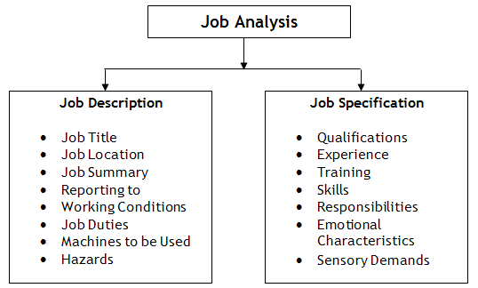
Human Resource Management
Starts with the Expressed Needs of the Organization
Provide input in job descriptions, including:
  Knowledge, Skills, Abilities, Other Characteristics (KSAOC)
  Job title & supervision statement
  Domains & competencies needed
  Education, experience &
  special requirements

Slide 93

Human Resource Management
Recruit, hire & dismiss personnel
  Must be non-discriminatory & inclusive
  Disciplinary action must be progressive in nature
Conduct regular performance appraisals
  Probation & Compensation
  Involve Staff Training & Improvement

Slide 94
Staff Supervision
Develop staff work schedules
Appropriately assign work tasks based on the seven dimensions that motivate & impact staff retention
Physical exertion/ability
Environmental pleasantness
Physical location of work
Time
Degree of human interaction
Competency
Psychological characteristics

Slide 95
Supervisor Tasks
Conduct New Staff Orientation
Supervise Subordinates, Interns/Fieldwork Students
Recruit, Supervise, Evaluate & Recognize Volunteers
Manage Time Cards, Payroll, Employee Records
Design & Conduct In-Service Training Programs
Conduct Staff Motivation Activities
Establish Staff Recognition Programs
Conduct Staff Meetings
Review/Respond to Employee Grievances

Slide 96

Volunteer Management
Follow similar standards as staff in terms of recruitment, supervision and training.
Intrinsic and extrinsic benefits
Recognition of contributions is vitally important.

Slide 97
FINAL COURSE EXAMINATION

Slide 98
CPRP POST PRACTICE TEST
LET’S SEE HOW YOU DO??
REMEMBER:
COMMON SENSE
THINK NATIONALLY
LOOK FOR THE BEST ANSWER!!!
READY?

Slide 99
1. A park and recreation professional has been assigned responsibility for planning a day camp program. The budget is $8,000, and policy dictates that this program receive no more than a 25% subsidy. At a level of 50 participants, what is the per person cost of the subsidized program?
A. $40
B. $120
C. $160
D. $200
2. Which of the following documents is most often needed for a major acquisition from external vendors?
A. cash receipt
B. purchase order
C. invoice voucher
D. check voucher
Notes:
1-b
2=B

Slide 100
Revenue from fees and charges was not sufficient to offset the cost of an agency's annual Fun Run. Which of the following funding sources would be best suited for this type of activity?
A. government grants
B. reimbursements
C. United Way
D. commercial sponsorships
When projecting capital improvements for a municipal park and recreation system, the most reasonable planning period would be for
A. 1 year.
B. 2 years.
C. 5 years.
D. 20 years.
Notes:
3-D
4=C

Slide 101
By policy, a park and recreation agency will provide a 50% subsidy for youth athletic programs. The following data are available:
YOUTH BASEBALL PROGRAM
EXPENDITURES REVENUES
Field Maintenance $10,000 Registration $13,000
Personnel $14,000 Sponsor Fees $15,000
Equipment and Supplies $30,000
Utilities $8,000
Insurance $2,000
Based on this information, what is the maximum amount of subsidy this agency will provide for this program?
A. $18,000
B. $24,500
C. $32,000
D. $36,000
Notes:
5-C

Slide 102
The most important factor in the retention of volunteers is effective
recognition.
evaluation.
coordination.
training.
The most important reason for the park and recreation supervisor to document the need for disciplinary action is to
A. protect the supervisor.
B. terminate the employee.
C. provide factual details.
D. prevent legal action.
Notes:
6 – A
7-C

Slide 103
The implementation of appropriate risk management policies and procedures should reduce an agency's
A. maintenance cost.
B. right of due care.
C. program attractiveness.
D. cost of insurance.
Which of the following is the best way to communicate work rules and policies?
A. Discuss them at in-service training sessions.
B. Distribute the policy manual to each new employee.
C. Hold essential employee hearings.
D. Post them in prominent locations.
Notes:
8-D
9-A

Slide 104
.
10. The underlying purpose of a marketing plan for a public organization is to
A. determine community needs.
B. serve more people.
C. establish an annual advertising campaign.
D. expand media coverage.
11. Which of the following is the best method to evaluate a promotional campaign used for a special event?
A. Monitor attendance patterns.
B. Conduct exit interviews of participants.
C. Organize a focus group.
D. Conduct a cost-benefit analysis of the event.
Notes:
10-B
11-B

Slide 105
12. In the fall, enrollment in Monday night programs declines. Participants have indicated difficulty arriving on time. Which of the following elements of the marketing mix should be investigated?
A. pricing strategy
B. place
C. publicity
D. market timing
13. Responding to customer complaints in a timely manner is an important part of
A. conflict resolution.
B. problem-solving.
C. public relations.
D. social service.
Notes:
12-B
13-C

Slide 106
14. Which of the following are appropriate ways for a park and recreation professional to network with related organizations in the community to maximize efforts and services?
A. frequent e-mails and phone calls with peers from other organizations
B. implementation of market segmentation within the community
C. attending monthly meetings of local governance or community social services
D. sharing newsletters with peers from other organizations
Notes:
14-C
15-B

Slide 107
15. A park and recreation agency is not required to make all facilities accessible as long as programs offered in inaccessible facilities
A. are available in alternate accessible facilities.
B. have staff to get participants to the program area.
C. are all moved to an accessible facility.
D. are advertised that they are held in an inaccessible facility.
16. The most appropriate tournament format for determining a winner in the least amount of time is a
A. round robin.
B. ladder.
C. challenge.
D. single elimination.
Notes:
16-A
17-D

Slide 108
17. Which of the following are the two most important outcomes when conducting registration?
A. accountability of records and ease of enrollment
B. participant satisfaction and accurate receipts
C. accounting accuracy and daily deposits
D. revenue security and staff scheduling
19. When leading a recreation program, the park and recreation professional should be primarily concerned with
A. assessing participant skills.
B. accomplishing program goals.
C. obtaining waivers from participants.
D. staying within the budget.
Notes:
18-A
19-B

Slide 109
19 How many individuals must be surveyed to obtain 1,250 completed evaluations from a softball league with 6,000 participants, if the expected return rate is 50%?
A. 625
B. 1,250
C. 2,500
D. 3,000
20. The primary purpose of risk management is to reduce risks associated with
A. daily operations.
B. participation of volunteers.
C. agency money management.
D. hiring practices.
Notes:
20-C
21-A

Slide 110
21. Inventory inspections to verify an agency’s fixed assets should be conducted
A. weekly.
B. monthly.
C. quarterly.
D. annually.
23. A community has 10 tennis courts developed in three park areas. The population is 125,000 and the community standard is one court per 5,000 people. How many new courts are needed?
  A. 5
  B. 10
  C. 15
  D. 25
Notes:
22-D
23-C

Slide 111
23. A stripped thread is noted on a U-bolt holding a playground swing, and the condition cannot be corrected. Which of the following actions would be most appropriate?
A. Place a warning sign on the swing.
B. Call maintenance to report the problem.
C. Remove the swing from service.
Fill out a written report to document the problem.
24. An employee arrives at a facility to open it for public use. Which of the following should be the employee's first action?
Clean floors, windows, and activity areas.
Inspect all areas and equipment for hazards.
C. Prepare rosters and enrollment forms for use.
D. Organize subordinate staff for the day.
Notes:
24-C
25-B

Slide 112
? QUESTIONS ?

